Slide 1
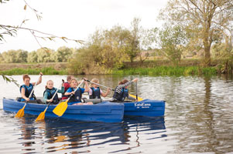
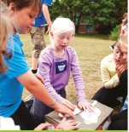
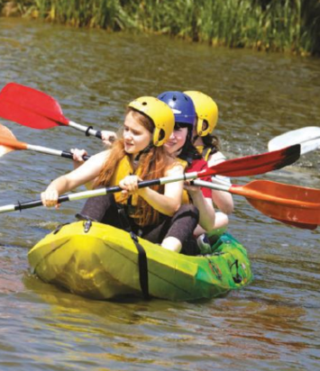
Croft Farm– Year 5
5-8th May 2026
‘We not only provide the ultimate adventure trip, but also an outdoor learning experience that allows every primary school child to grow. Teachers are enabled to help pupils excel in a safe, fun and friendly environment through a series of activities aimed to meet learning outcomes and create memories.’

Slide 2
The Value of JCA Croft Farm
We believe that learning outside the classroom is essential to a well-rounded education. Our courses focus on engaging students , providing enjoyable learning, and helping to develop life skills, such as:
Learning to work together as a team
Achieving personal and team goals
Increasing self esteem and confidence
Conquering fears
Trying new and exciting activities
Experiencing living away from home
Respecting and valuing each others abilities
Revealing undiscovered strengths
Solving problems and taking responsibility

Slide 3
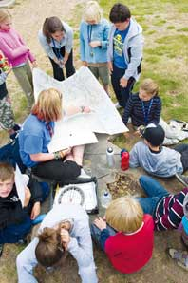
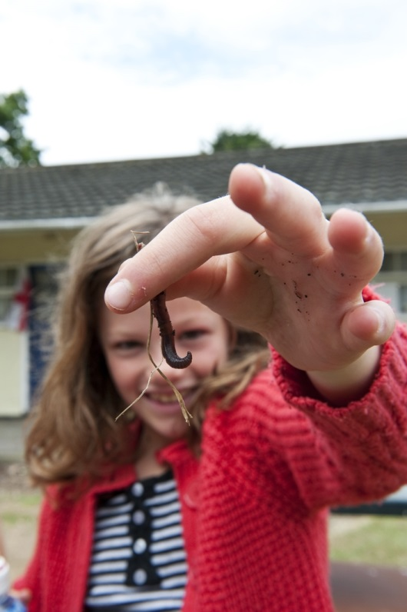
National Curriculum Coverage
Our programmes are linked to the Key Stages 2, 3 and 4 of the National Curriculum. Our standard Action and Adventure programme offers the opportunity to cover aspects of:
PE
PSHE
Literacy
Science
Geography
Citizenship
Design & Technology
Maths

Slide 4
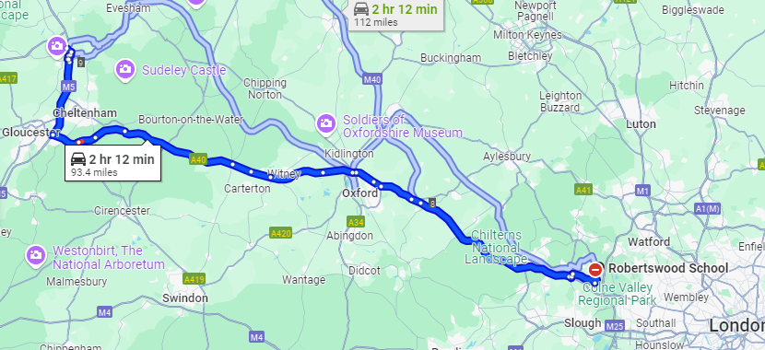

Slide 5
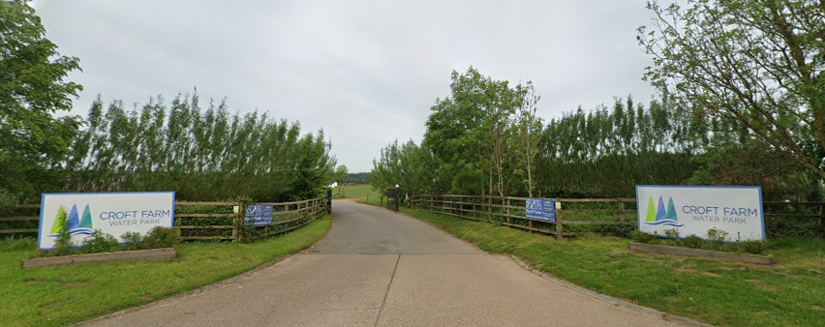

Slide 6
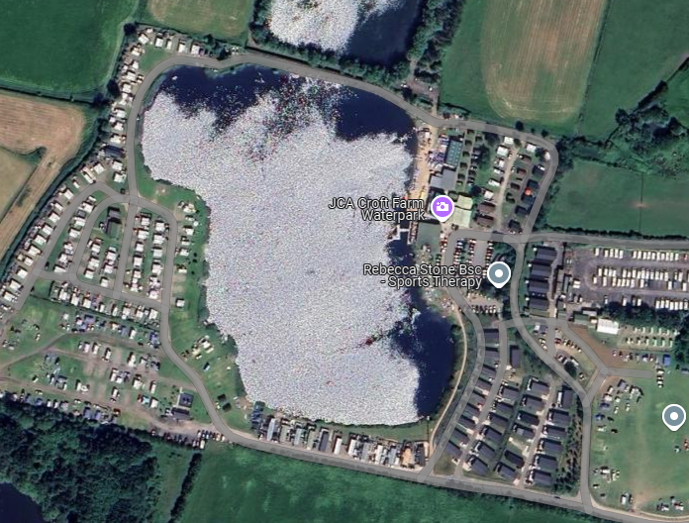
Located in the heart of the Cotwolds near the historic town of Tewkesbury. Croft Farm boasts its own 12 acre lake.

Slide 7
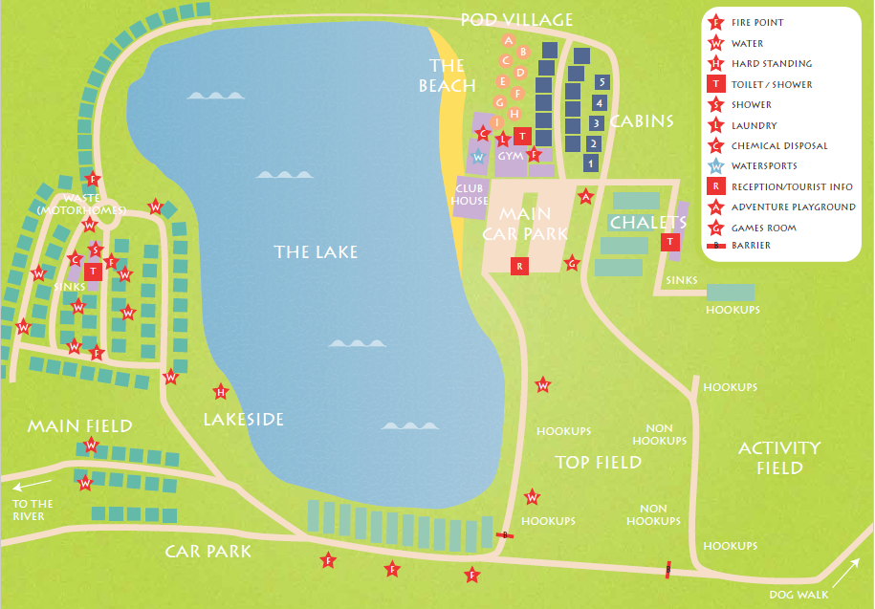

Slide 8
Croft Farm JCA – Year 5
5th – 8th May 2026
Activities
Chalets/cabins (Up to 4 in a room)
Food
What to bring

Slide 9
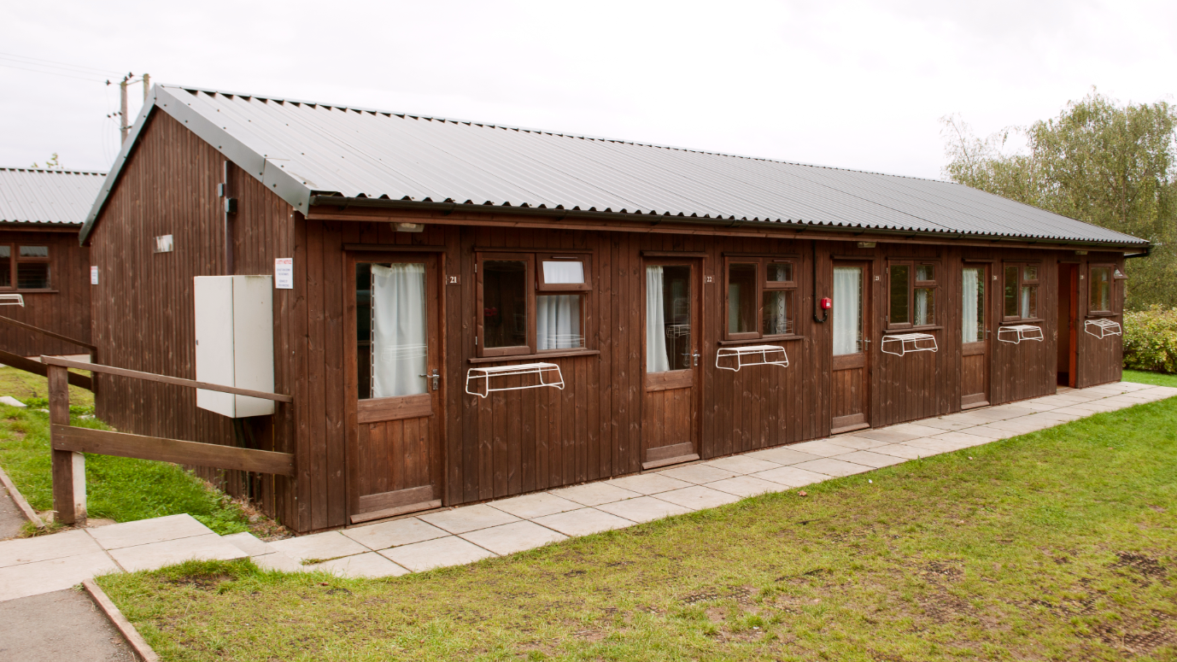
Safely-enclosed four-person heated chalets, located in close proximity to the toilet and shower blocks, with 24-hour security.

Slide 10
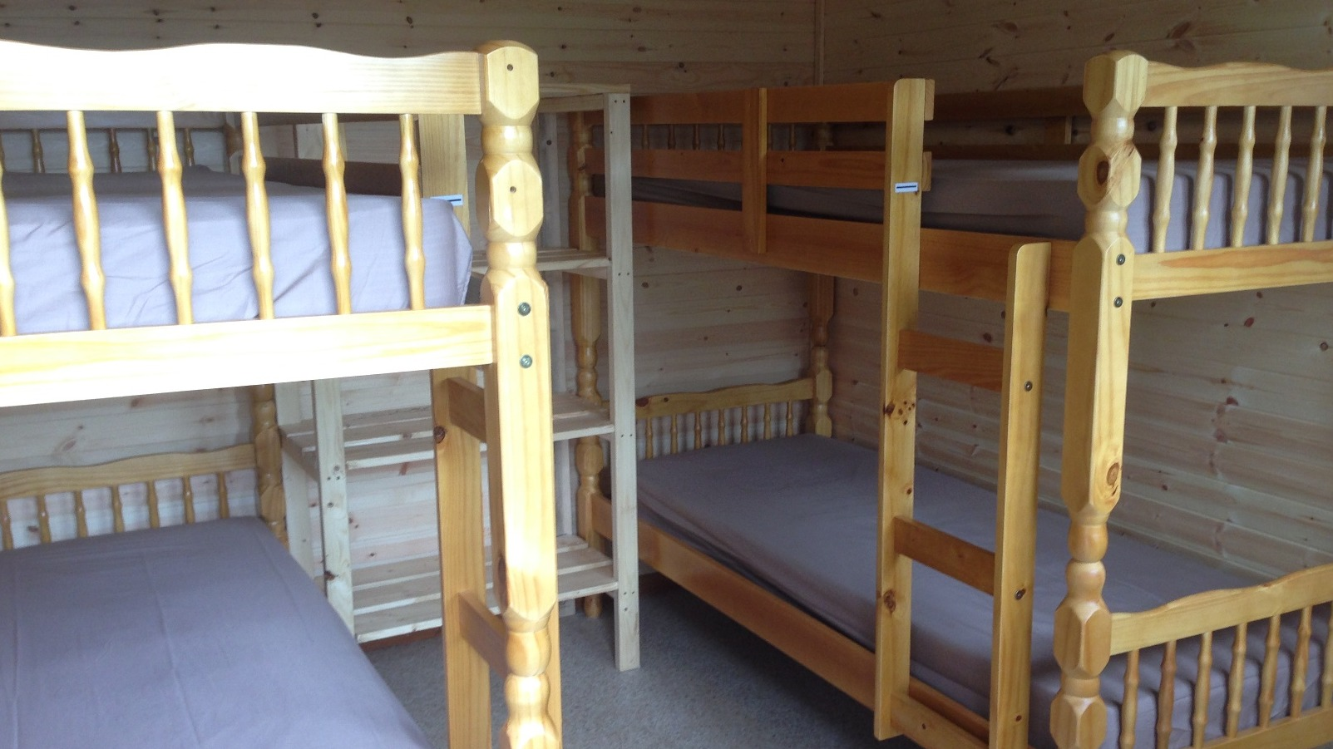
Students will be required to bring their own bedding - a sleeping bag and pillow.

Slide 11
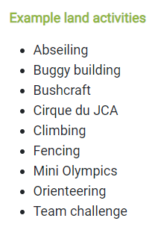
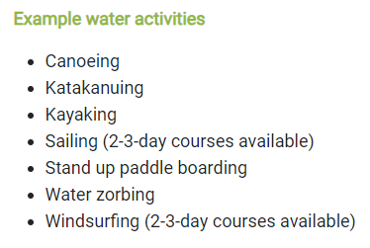
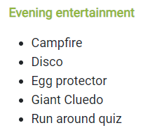
Possible activities

Slide 12
Sample itinerary
 | Morning |  | Afternoon |  | Evening
Sessions | 1 | 2 | 3 | 4 | 5
Tuesday | Travel to Croft Farm |  | Intro Tour | Archery | Giant Cluedo
Wednesday | Kayaking |  | Orienteering | Sensory Trail | Egg Protector
Thursday | Fencing | Climbing | Raft Building |  | Disco
Friday | Canoeing |  | Travel back to school

Slide 13
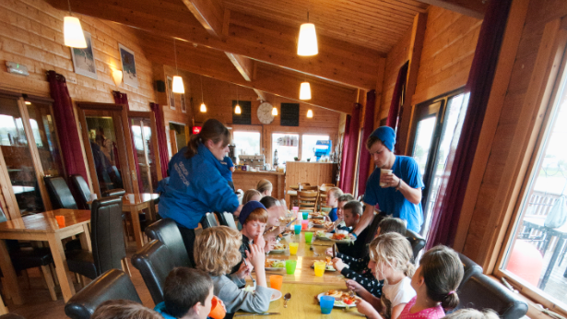
Food
Breakfast
Lunch
Dinner

Slide 14
What to bring
Plenty of change of clothes
Swimwear
Towel
Wet weather clothing and footwear (wellies/walking boots)
Footwear that can get wet (old trainers)
Footwear that will be kept dry
Indoor shoes
✓ Long sleeves
✓ Day bag (for drink bottle – extra layer – waterproof coat)
Camera (plenty of batteries or charger)
Book / cards (especially for quiet time)
Bedding – pillow and sleeping bag
X smart watches / electronic devices
X additional food

Slide 15
Any questions?

